Slide 1
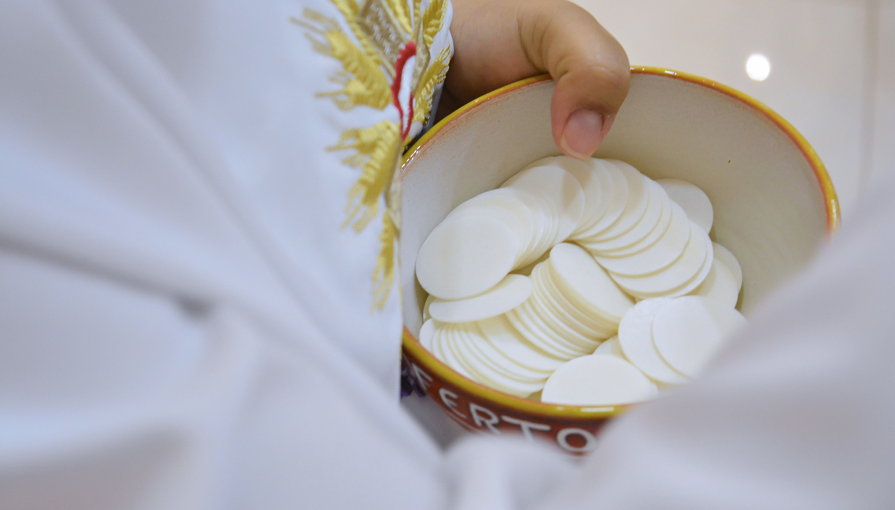

STEWARDSHIP WEEKENDS
Help us to Build Eight New Ministries Identified in our Parish Renewal Plan
September 12 & 13
September 19 & 20
2026

Slide 2
OUTREACH MINISTRY
The Outreach Ministry is a vital expression of our parish’s mission to live out Christ’s call to love, welcome, and serve one another. This ministry reaches out to those who may not feel fully included in parish life, including the newly initiated, seniors, singles, and those who no longer attend Mass regularly. Through compassion, presence, and meaningful connection, the Outreach Ministry helps individuals feel valued, supported, and connected to the parish community. Volunteers are invited to share their time and gifts in a spirit of faith and service, helping to build a more welcoming and inclusive parish where all are reminded that they belong.

Slide 3
HOSPITALITY
WELCOME DESK MINISTRY
The Hospitality Welcome Desk Ministry aims at creating a warm, inclusive, and welcoming presence at every weekend Mass through a Hospitality Desk. This ministry provides a friendly first point of contact where volunteers greet parishioners and visitors, offer information about Masses, ministries, and events, and assist newcomers in feeling at home and connected within the parish community.

Slide 4
EVANGELIZATION MINISTRY
This ministry forms disciples equipped to share the Gospel in everyday life. Programs like ALPHA offer parishioners' pathways to encounter Christ and strengthen their faith. Volunteers contribute as hosts, mentors, and prayer partners, building a parish community centered on faith, fellowship, and mission.

Slide 5
RETREAT MINISTRY
Sacred spaces for prayer, reflection and spiritual renewal are at the heart of what the Retreat Ministry offers the parish. Volunteers plan for and organize retreats designed to help parishioners grow closer to Christ and to renew their faith.

Slide 6
ENVIRONMENT MINISTRY
The Environment Ministry crafts sacred worship spaces that reflect each liturgical season, helping parishioners connect more deeply with God. Creative volunteers are welcome to lend their talents in enriching the parish’s prayerful atmosphere.

Slide 7
LITURGY MINISTRY
Rooted in an understanding of the liturgical seasons and celebrations, this ministry enhances the sacred liturgy in a way that draws parishioners into deeper participation in the Mass. Volunteers with a knowledge of the liturgy and a reverence for the Church’s traditions are invited to offer their expertise in service, helping to foster a worship atmosphere that inspires faith, mission, and encounter with Christ.

Slide 8
SOCIAL OUTREACH MINISTRY
The Social outreach Ministry aims at fostering a spirit of compassion and service within the parish by establishing a ministry that offers parishioners meaningful opportunities to serve those who are less fortunate and vulnerable, through initiatives like Feed the Hungry. This ministry encourages encounters that deepen faith and solidarity by connecting parishioners with the needs of the wider community and inviting them to respond with generosity and care.

Slide 9
FAMILY EVENTS MINISTRY
The Family Events Ministry supports and strengthens family life within the parish by bringing families together to celebrate and grow through the liturgical year. By organizing meaningful events tied to the seasons and feasts of the Church, this ministry helps families deepen their faith, build lasting relationships, and experience the joy of parish life together. Volunteers play an important role in fostering a welcoming and faith-filled environment where families of all ages feel connected, supported, and encouraged.

Slide 10
Please Join Us!
September 12/13, and 19/20
For the stewardship weekends.

Slide 11
THANK YOU
St. Michael Catholic Community
We Love You❤️

